Slide 1
Introduction
The differential pressure sensor has shown promise, however 2 main issues
High cost compared to other sensor techniques ($40/sensor)
Potential issues down the line with sedimentation or corrosion
Magnetometer-based force sensor solves these issues
Low cost ($1.85/sensor)
No sedimentation issues
Ultra-low power consumption (100uW to 10mW)
High resolution (1 mN == equivalent to 0.1 g mass)

Slide 2

Magnetic Pressure Sensor
Urine Stream
Neodymium Magnet
F_{x}
Silicon Elastomer
F_{z}
F_{y}
Neodymium Magnet
Deformation
d₁
Silicon Elastomer
d₂
Magnetometer
Magnetometer
Force from urine stream causes shear and normal stress on elastomer, bringing the magnet closer/farther from the magnetometer. Magnetic field changes then corresponds to applied force

Slide 3
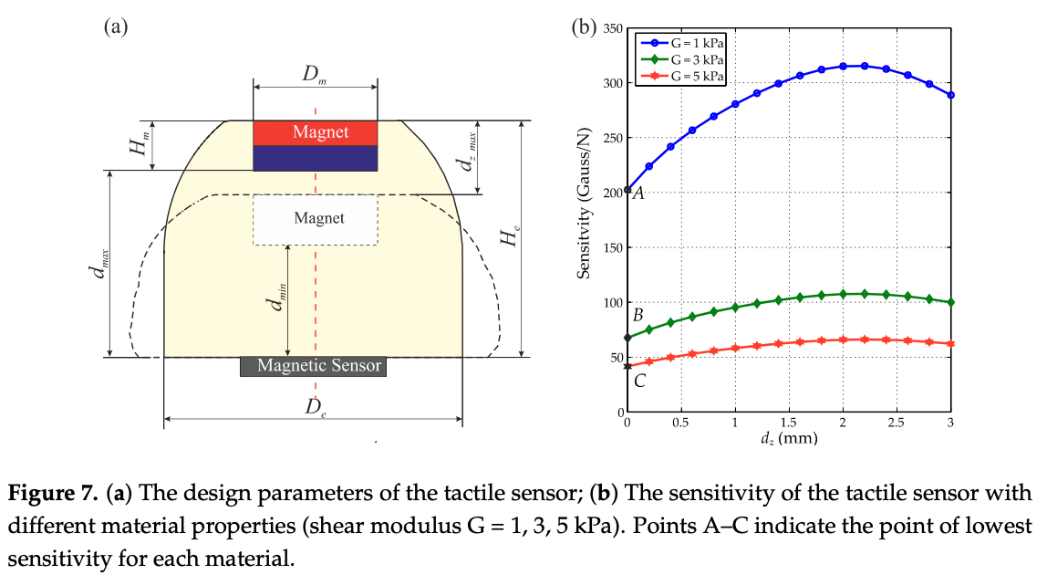

Slide 4
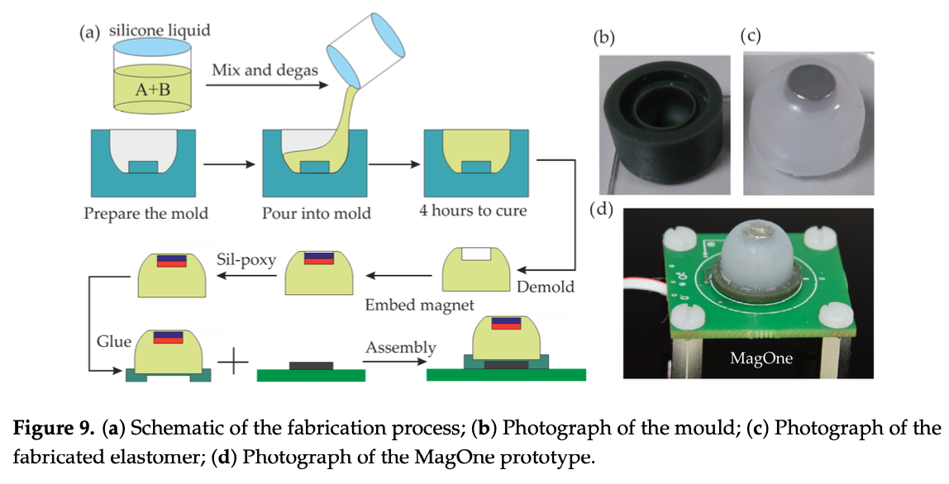
Manufacturing Process
3D Print Mold for Elastomer
Pour Elastomer (Si) into Mold and Cure
Attach the neodymium magnet to the indentation in the elastomer mold using Sil-poxy
Connect assembly to PCB using adhesives

Slide 5
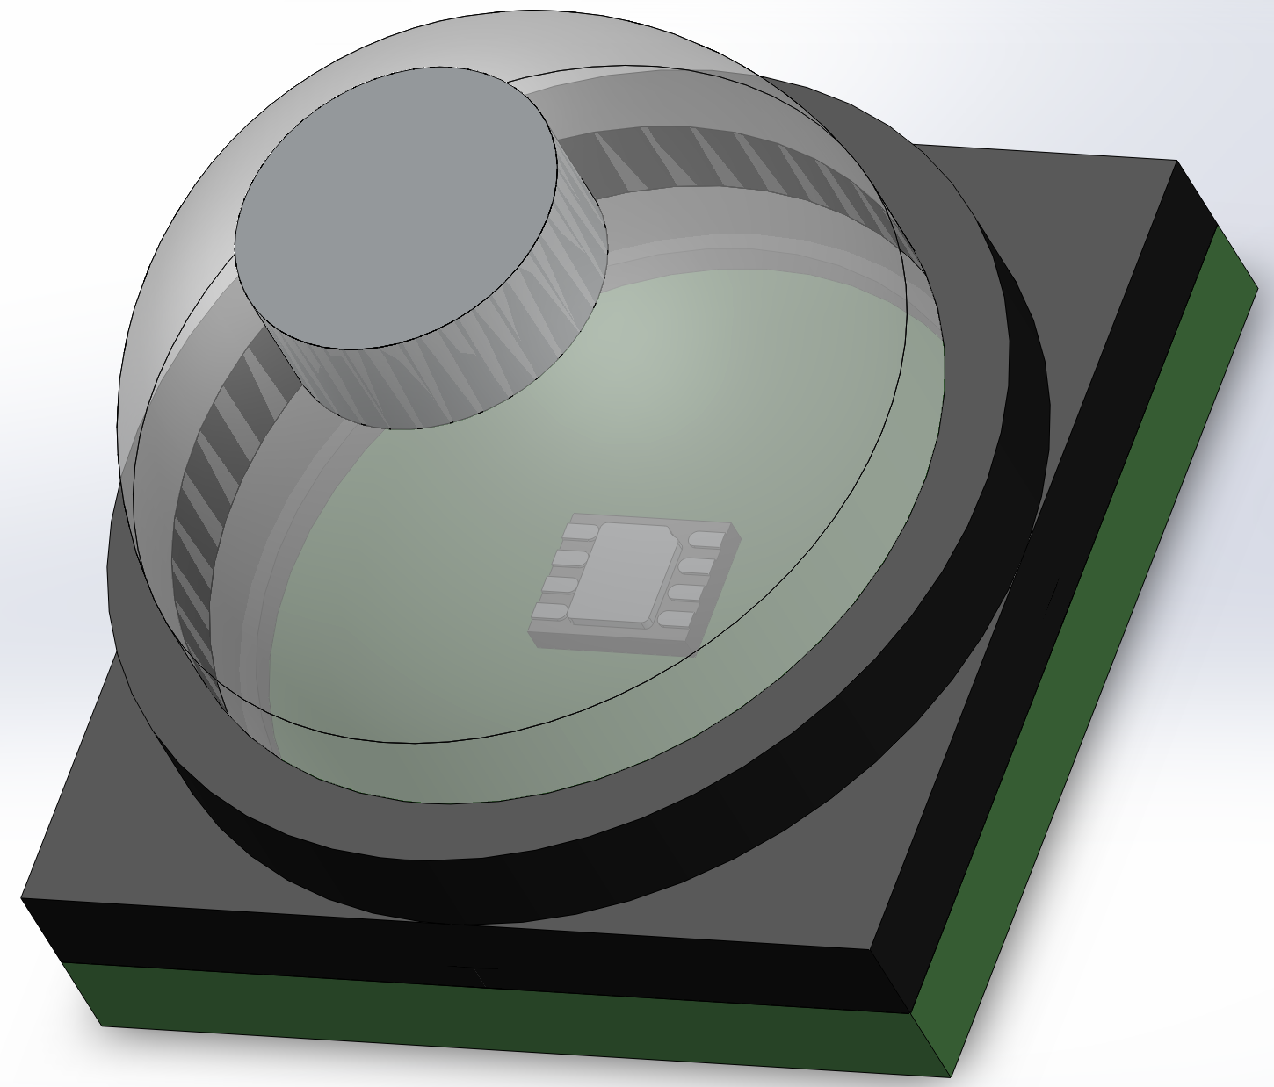
CAD Model
Neodymium Magnet
Silicon Elastomer
PCB Waterproof Casing
11.22mm
Magnetometer Sensor
PCB
14mm
14mm

Slide 6
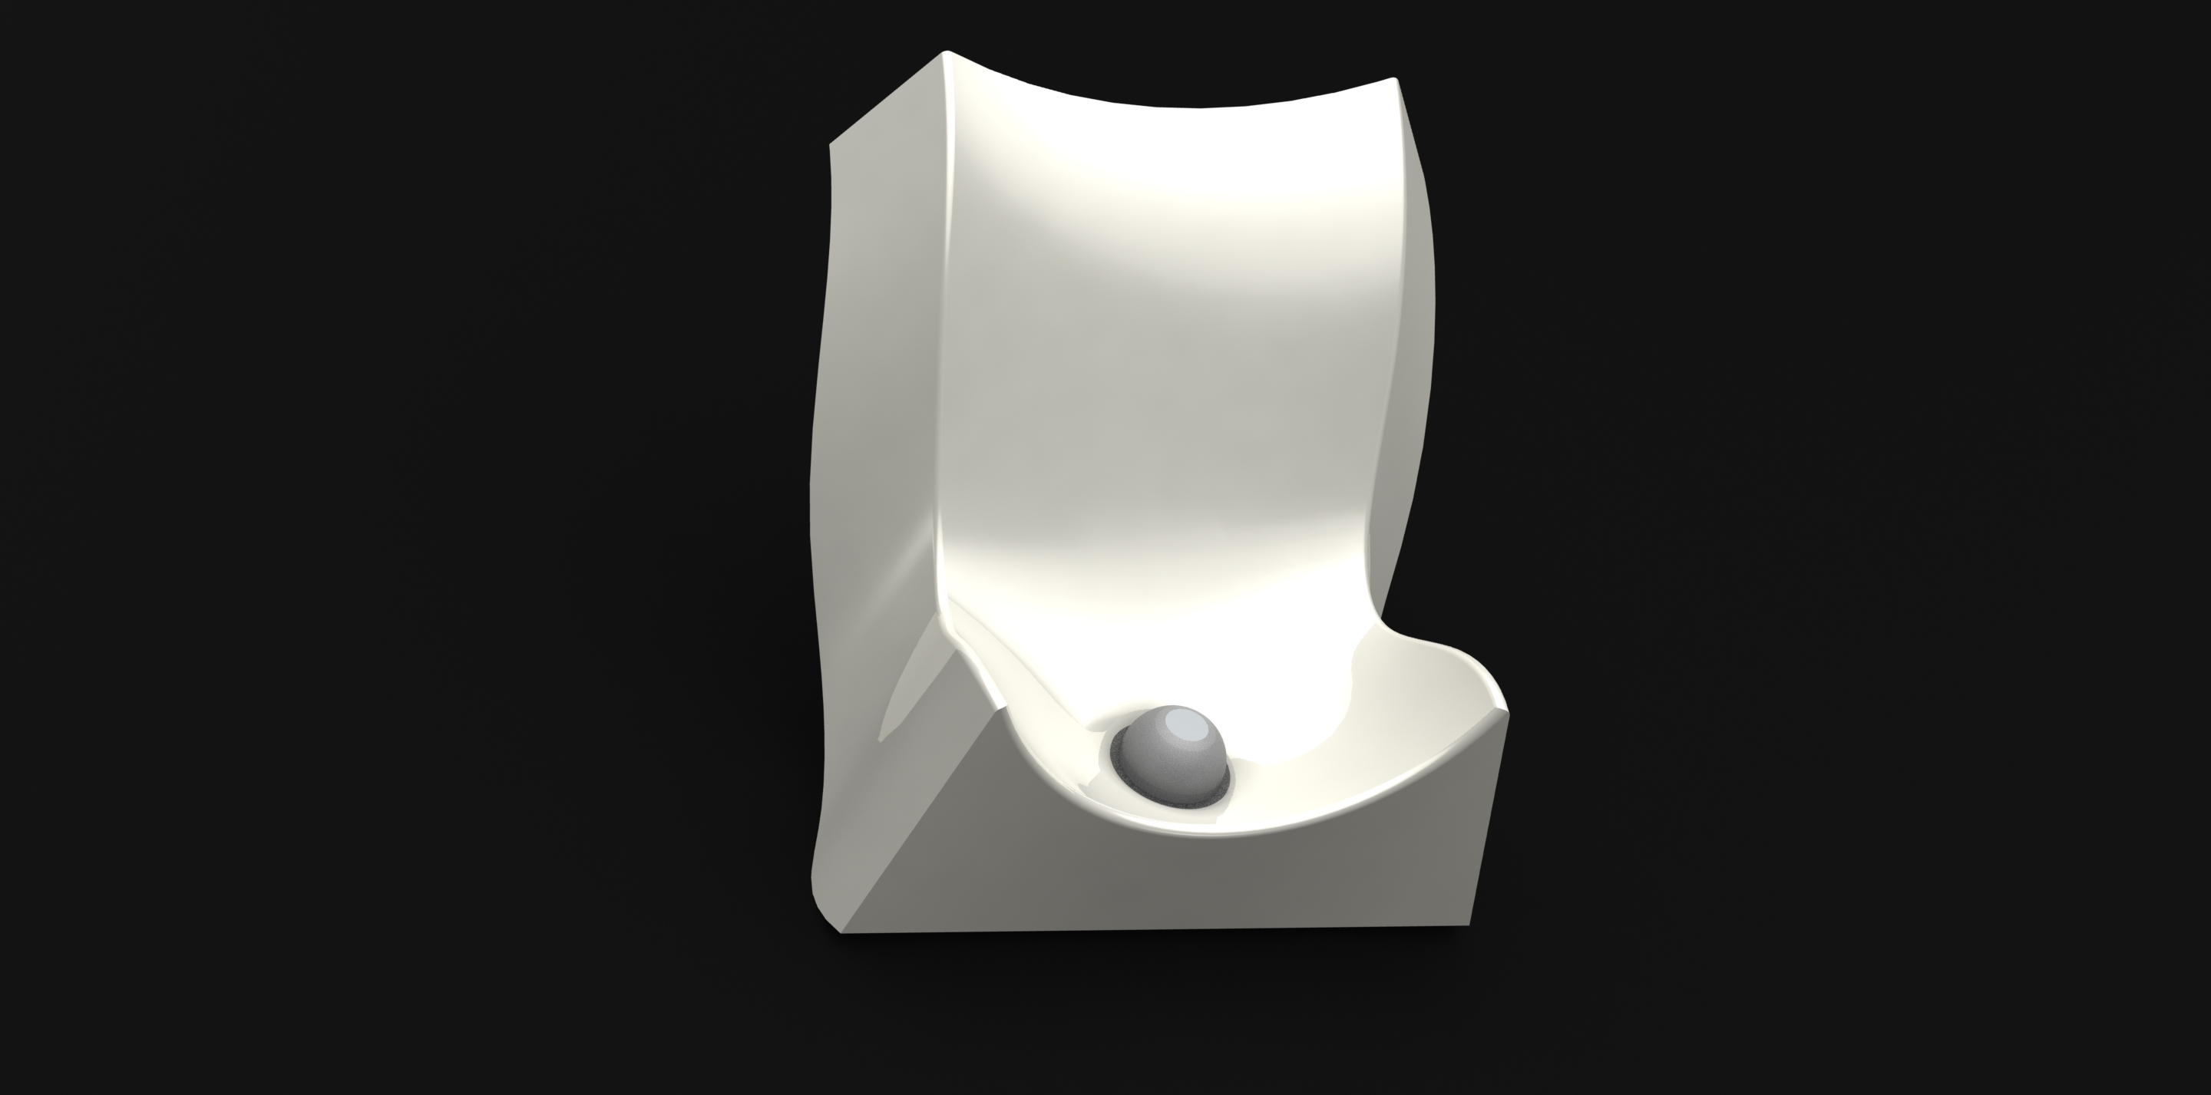

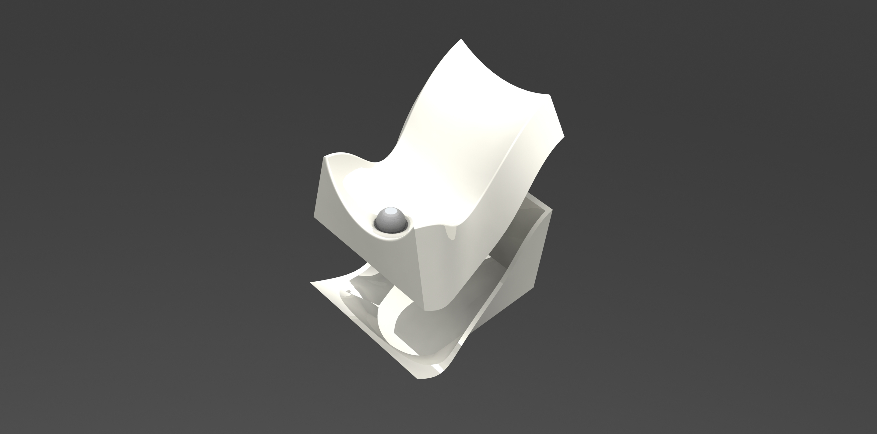
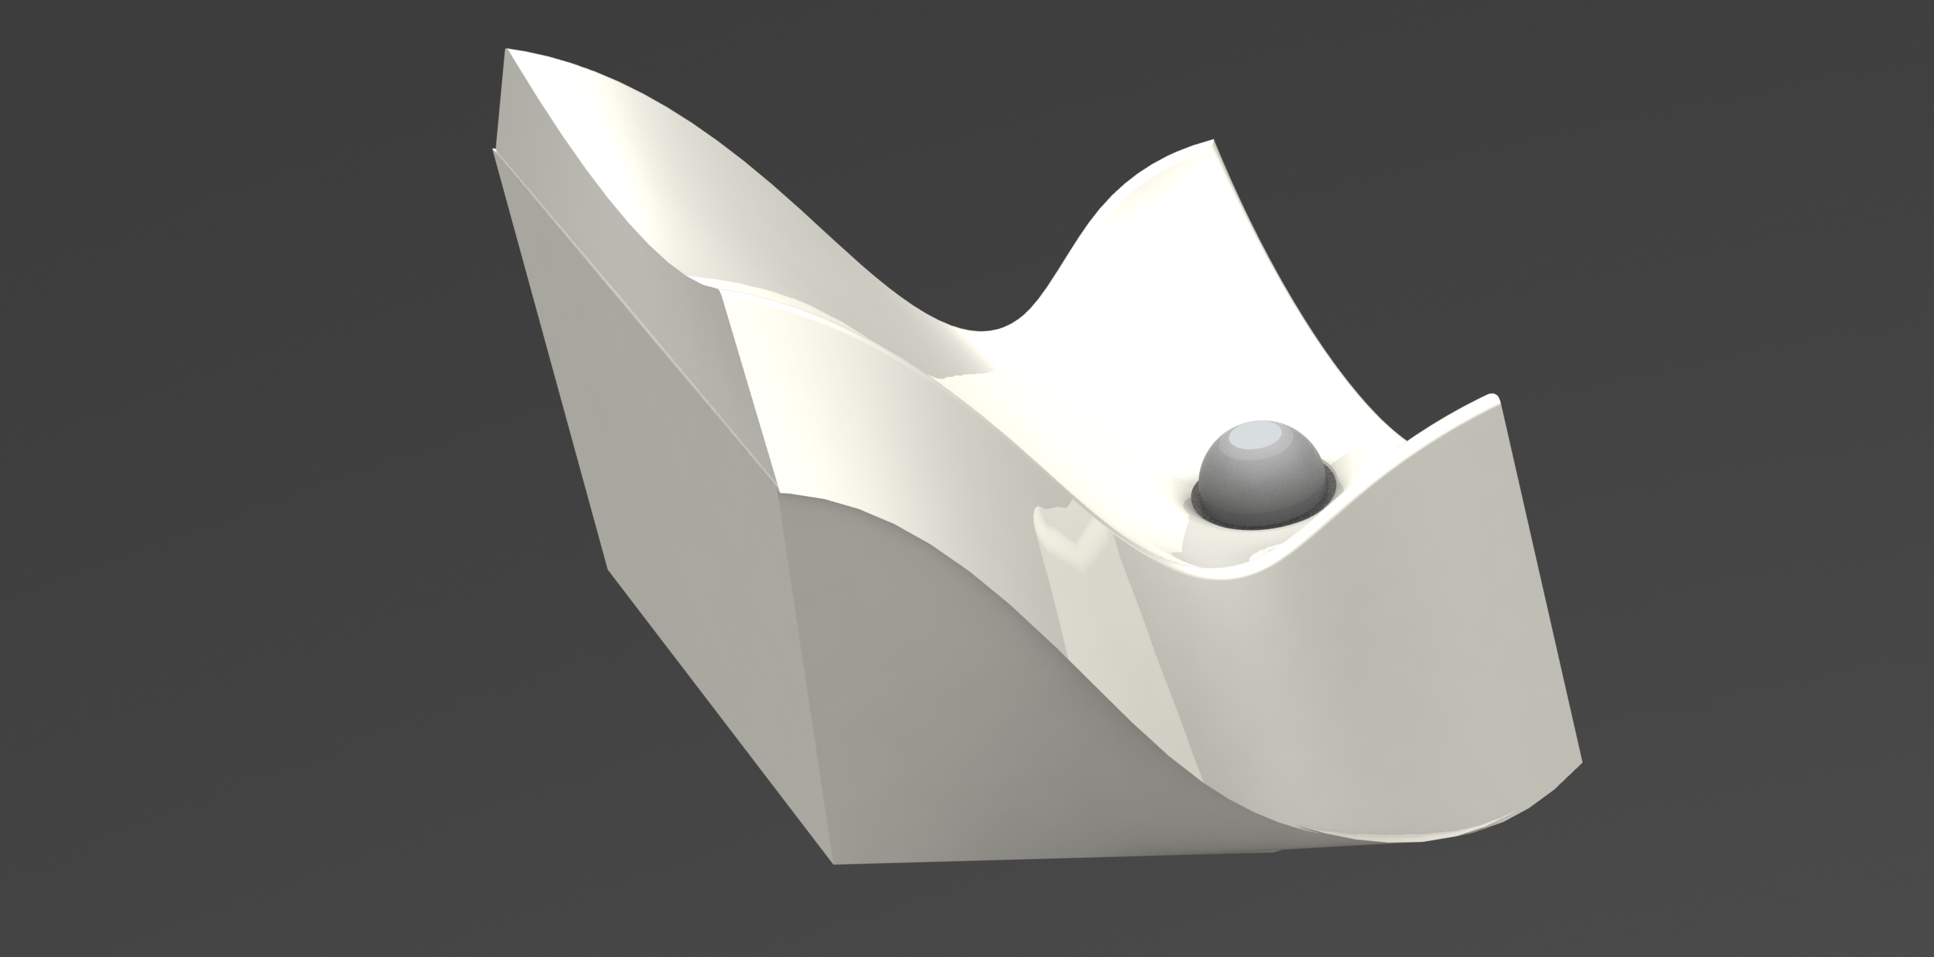
Integrated Casing Design

Slide 7
Further Considerations
May be difficult to manufacture, since elastomer must be prepared manually
Elastomer can deform over time due to creep effects, however the geometry of the elastomer and placement of the magnet at the top mitigates this
Lots of testing required and many different configurations (ie. Elastomer material, elastomer geometry, magnet size, magnetometer)
Tilting of magnet can cause inaccuracies – can be mitigated with IMU MEMS sensor

Slide 8
Prototype
To test the viability of this solution and compare performance with other sensor prototypes, I propose assembling a magnetic elastomer force sensor and testing the accuracy in a controlled environment
The test will be:
Using a water bottle, pour water onto the elastomer sensor using 2 test variations: 1) constant rate (simulating healthy) and 2) sputtering (simulating BPH)
Record the magnetometer data locally, either directly to the computer or on an SD card connected to the microcontroller
Record the true flow rate using the mass scale
Using the LSTM model from Mikayla’s rig, fit the data
Test the LSTM results

Slide 9
Prototype Materials
Item | Cost
Neodymium Magnets (5mm x 2mm) | $6.99
Magnetometer | $1.85
Microcontroller | Available in lab
Silicon | $42.99 (2lbs)
Sil-poxy | $5.98
Silicon Releasing Agent | $16.99
3D-print | Available in lab
Total Cost of Materials: $74.80

Slide 10
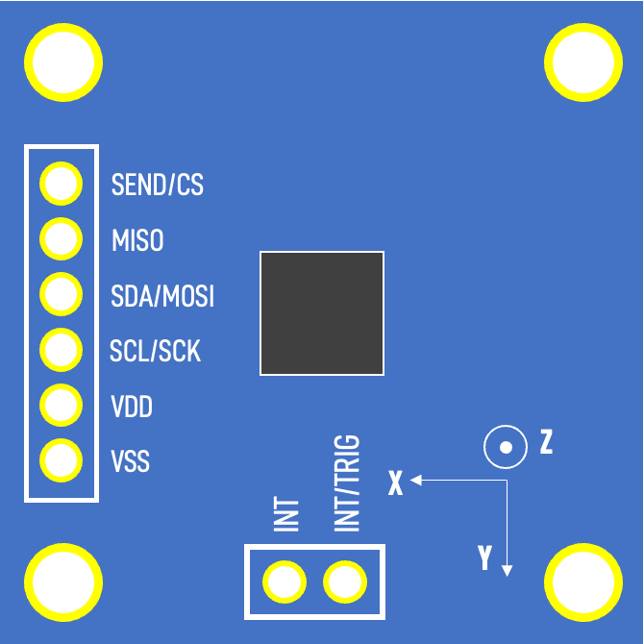
Sensor Pinout
FRONT
BACK
SEND/CS
MISO
30mm
SDA/MOSI
SCL/SCK
VDD
Z
VSS
INT/TRIG
INT
X
Y
30mm

Slide 11
HX711 Pinout
E+
E-
GND
A-
DT
A+
SCK
B-
VCC
B+

Slide 12
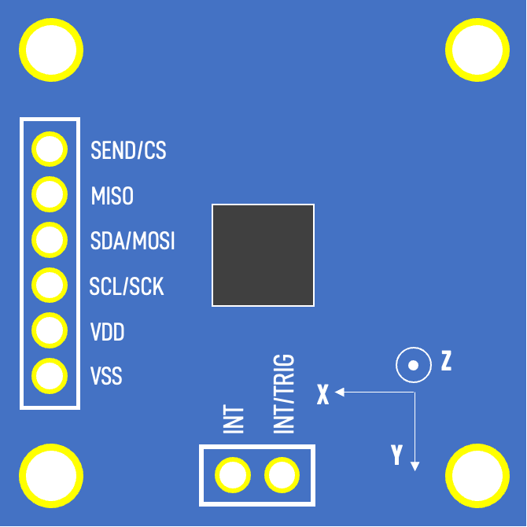
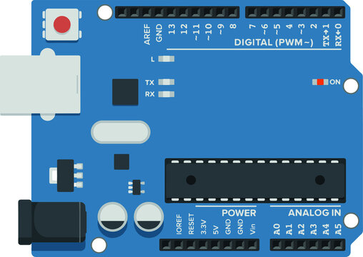
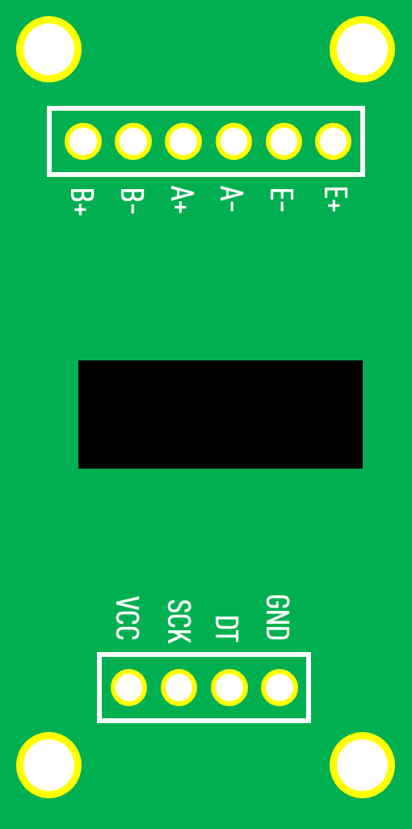
Circuit Schematic
3.3V
A5
HX711 Load Cell
0.1µF
A4
GND
10kΩ
MLX90393
Magnetometer
10kΩ
~D3
D2
GND
5V

Slide 13
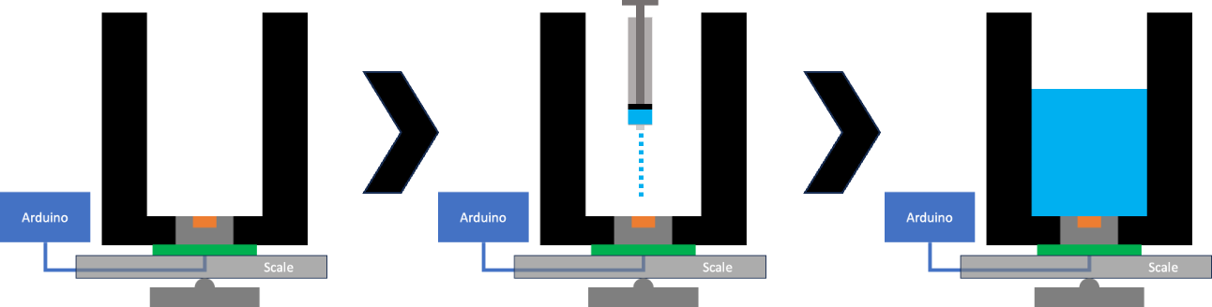
Static Water Calibration Procedure V1
Record a magnetometer reading when the container is empty of water
Measure out 2 mL of water using syringe and inject onto the elastomer
Press the button to record the magnetometer measurement of the B-field value
Manually record the mass of the water as shown by the digital scale
Repeat this until 125 mL of water has been added
Key
Container
Elastomer
Magnet
PCB

Slide 14
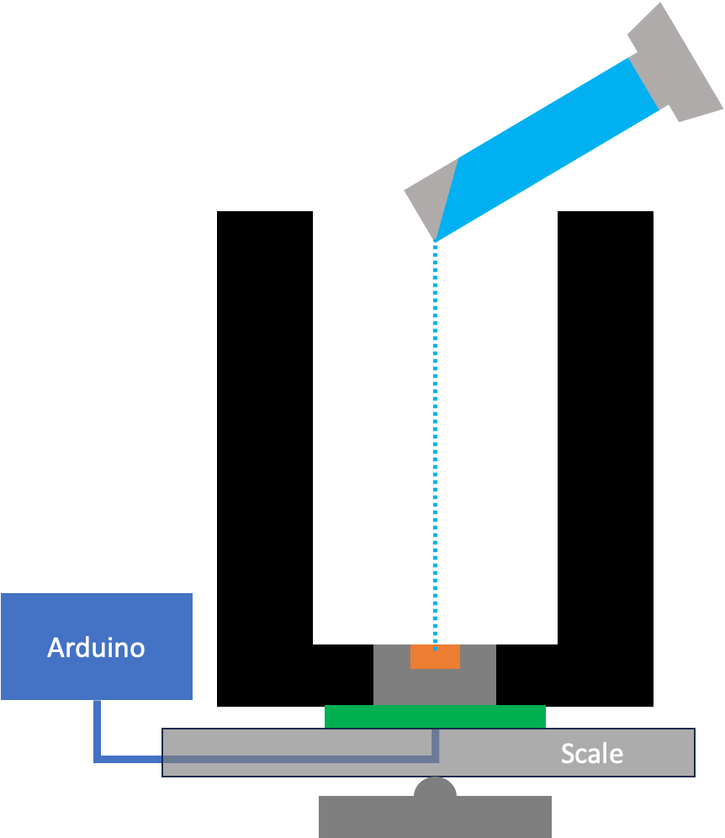
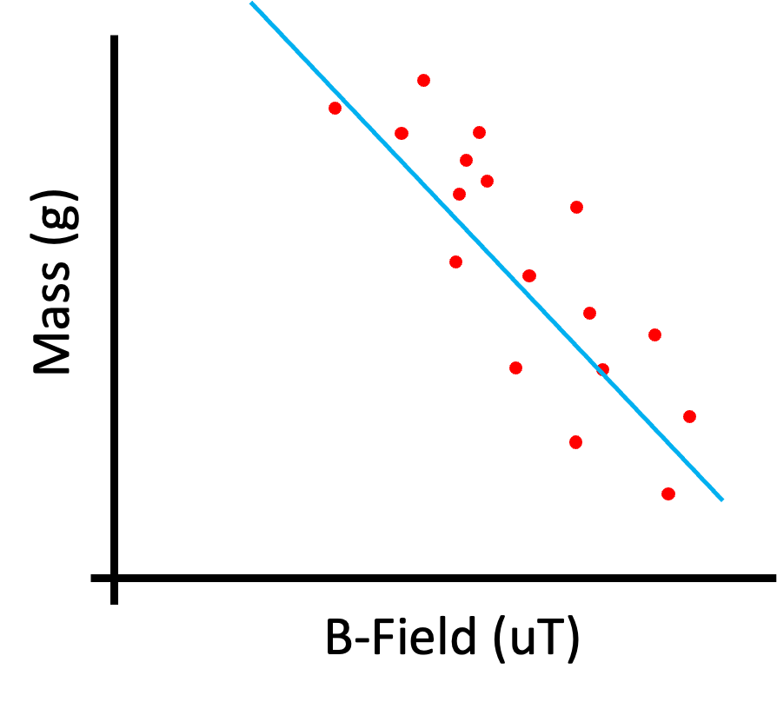
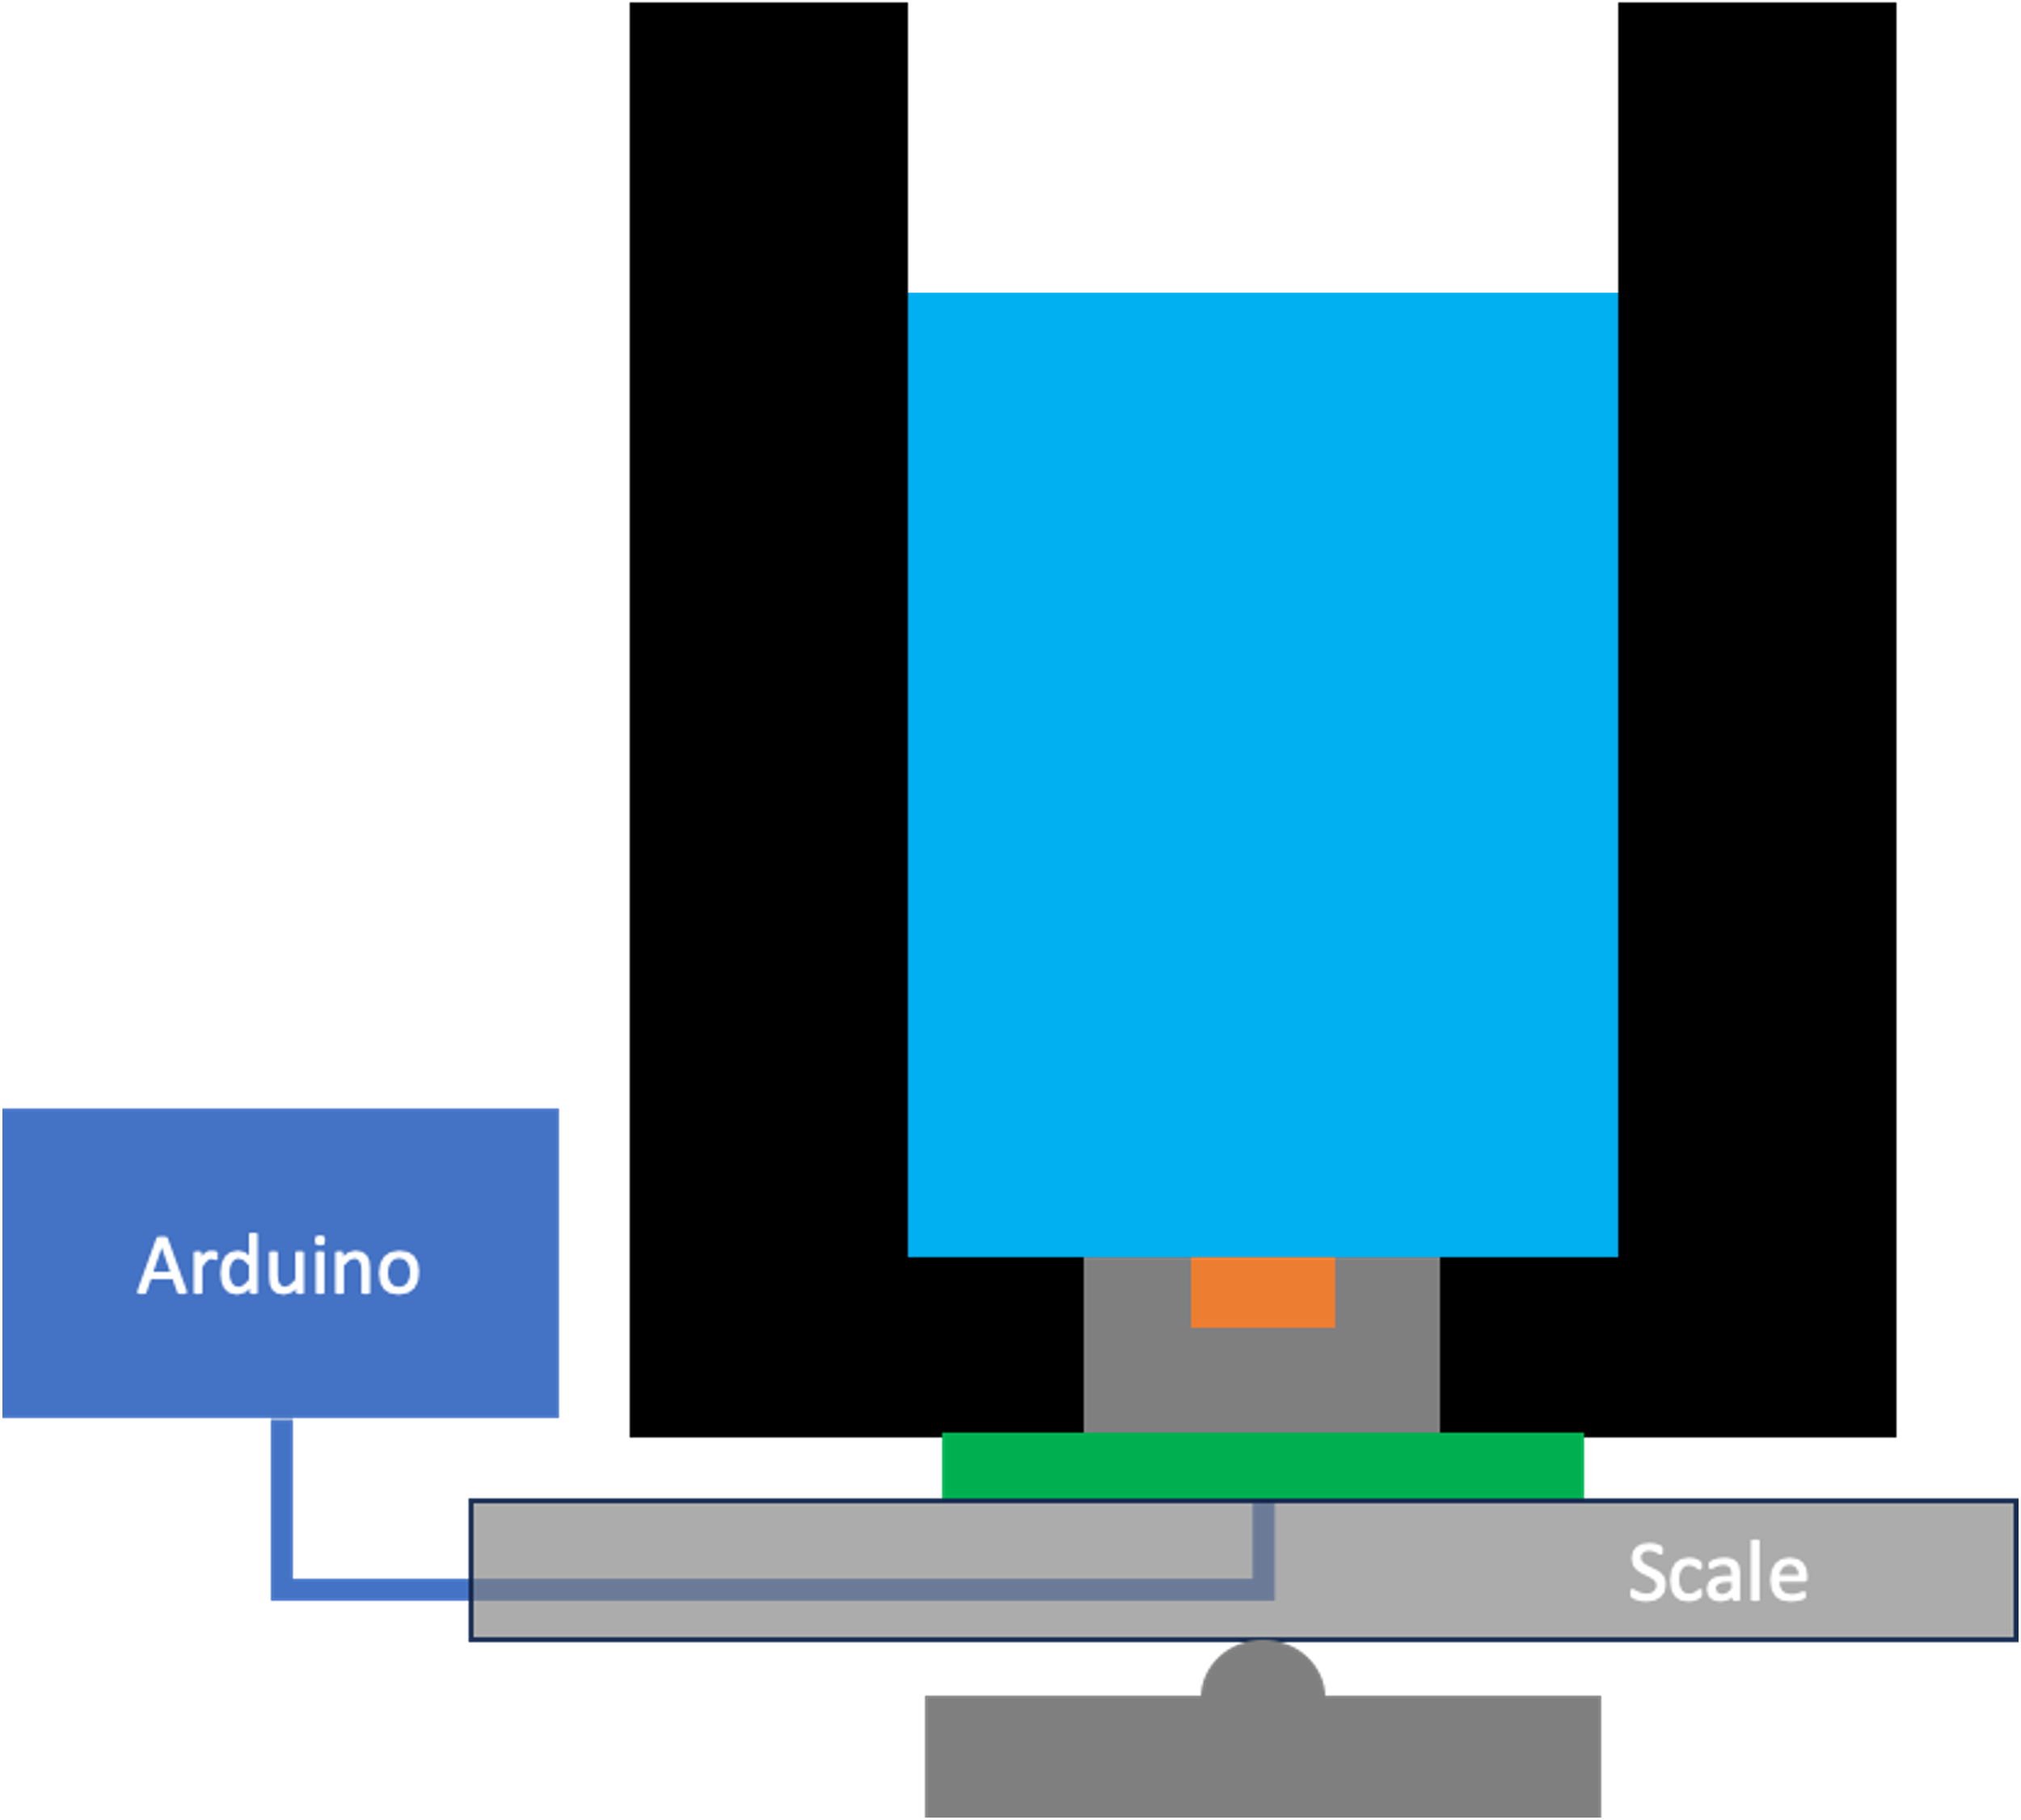
Static Water Test Procedure V1
Measure out 100 mL of water using the graduated cylinder
Inject the water onto the elastomer
Record the measured B-field value
Using the linear regression line of best fit from the calibration, calculate the predicted water mass from the B-field value
Repeat this for 6 trials and compare to true value of 100 g
Key
Container
Elastomer
Magnet
PCB

Slide 15
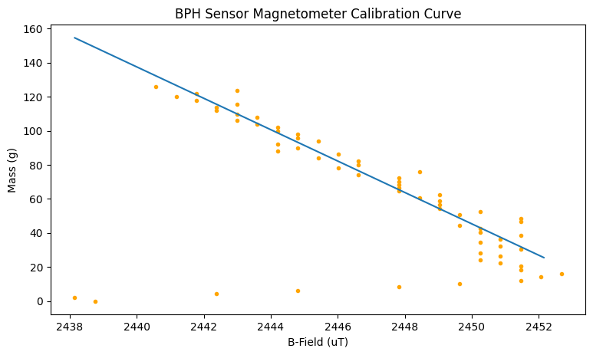
Static Water Experiment Data
Calibration Results
Test Results
Average | 104 g
Standard Deviation | 12.7 g
Accuracy | 95.9 %

Slide 16
Discussion
Notice the inconsistency with the low mass values (< 20 g). I realized that this was at approximately the mass of water required to completely cover the elastomer sensor. After this critical mass, the measurements are more accurate.

Slide 17
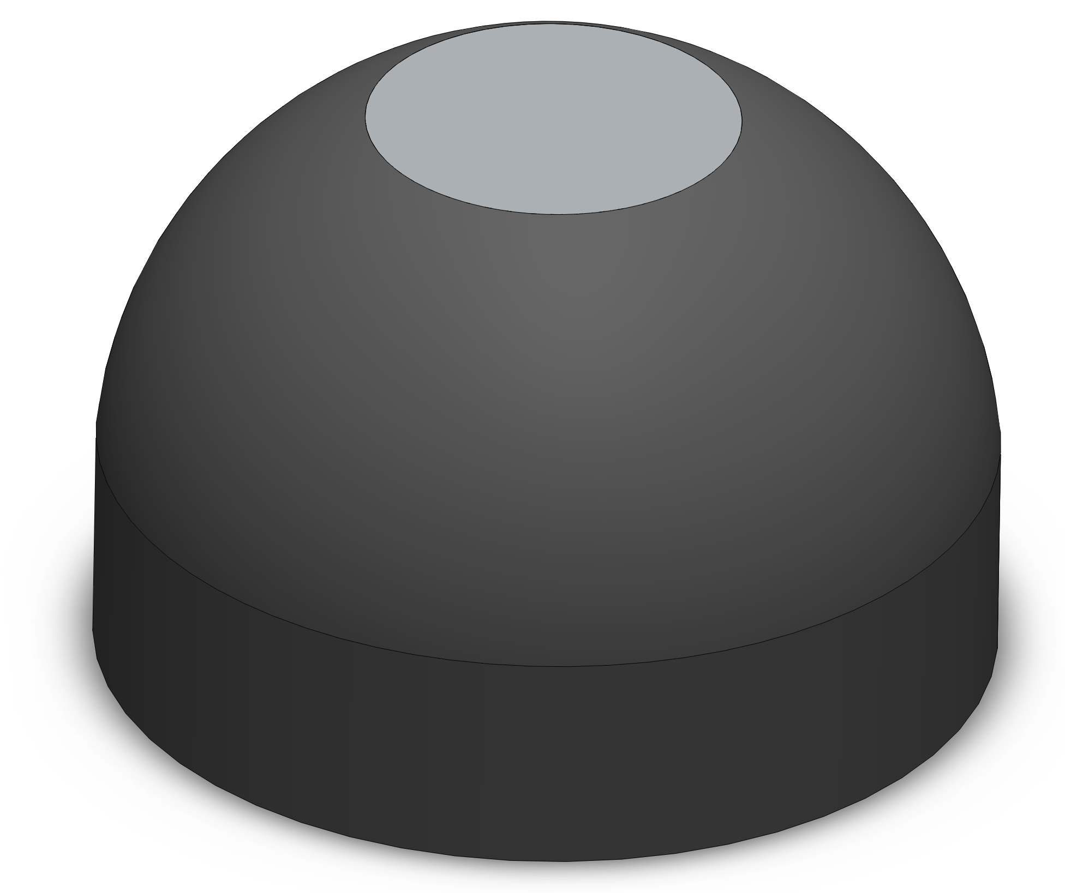
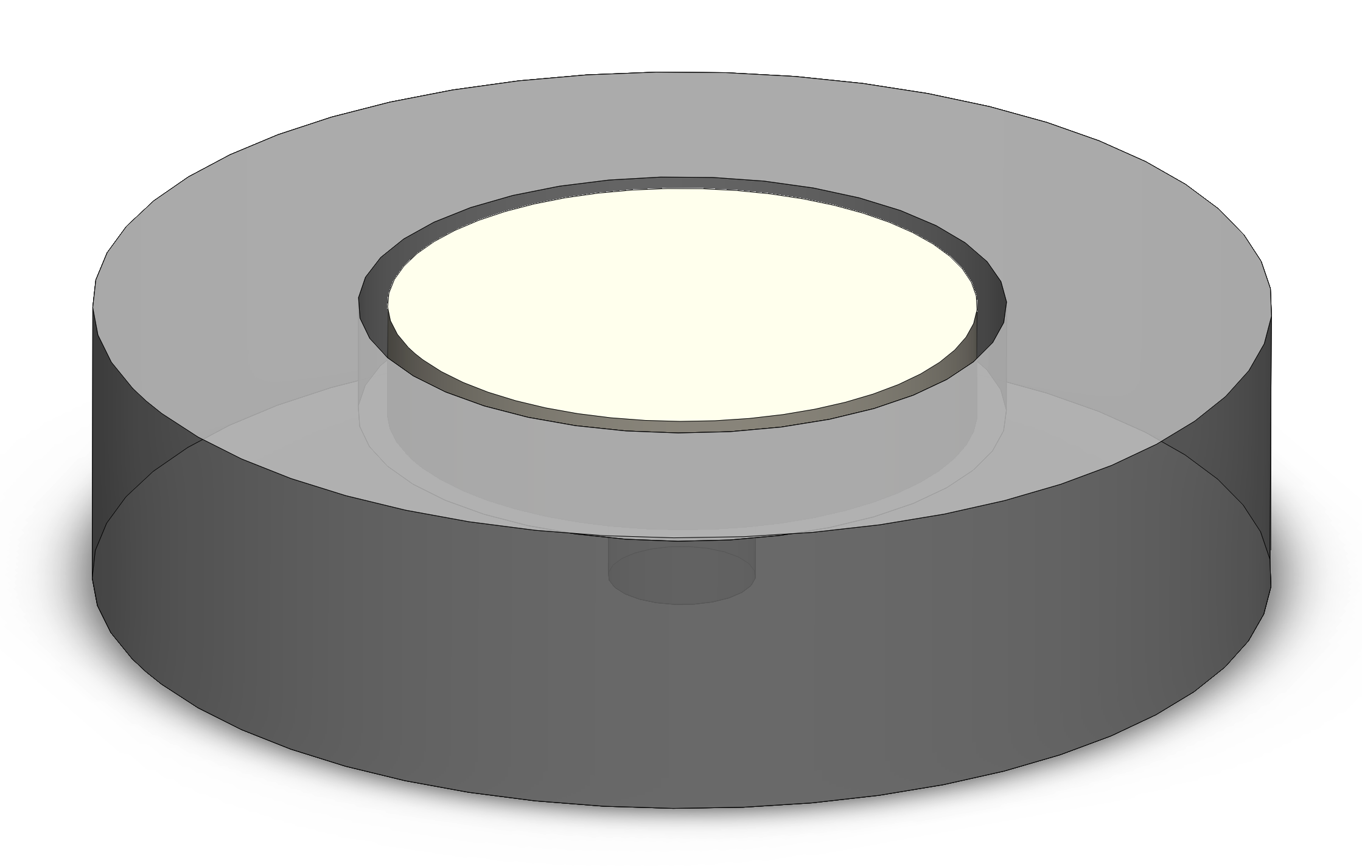
Discussion
To solve this, I redesigned the elastomer geometry to be flush with the surface of the container.
V1
V2

Slide 18
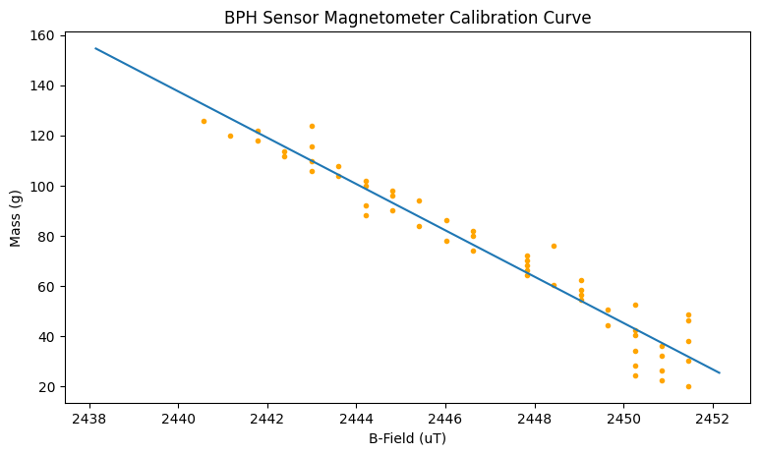
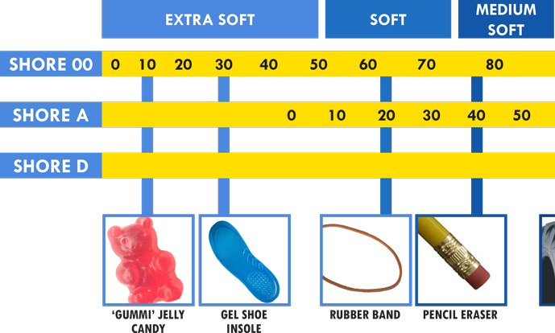
Discussion
Furthermore, the sensor reads the same B-field value for different masses. This indicates the current configuration is not sensitive enough to differentiate between these changes or the environmental B-field is non-negligible relative to the magnet B-field. To fix this, I am using larger magnets (from 5 mm to 10 mm) and softer silicones (from Shore 20A to Shore 00-50).

Slide 19
Static Water Calibration Procedure V2
Calibrate the load cell with the 10g lead weight
The circuit will begin recording both, the mass and the B-field automatically
Add 2 mL of water after ~150 readings at the previous mass
Repeat this until 100 mL of water has been added
Key
Container
Elastomer
Magnet
PCB

Slide 20
Static Water Test Procedure V2
Measure out 100 mL of water using the graduated cylinder
Inject the water onto the elastomer
Record the measured B-field value
Using the polynomial fit from the calibration, calculate the predicted water mass from the B-field value
Repeat this for 6 trials and compare to true value of 100 g
Key
Container
Elastomer
Magnet
PCB

Slide 21
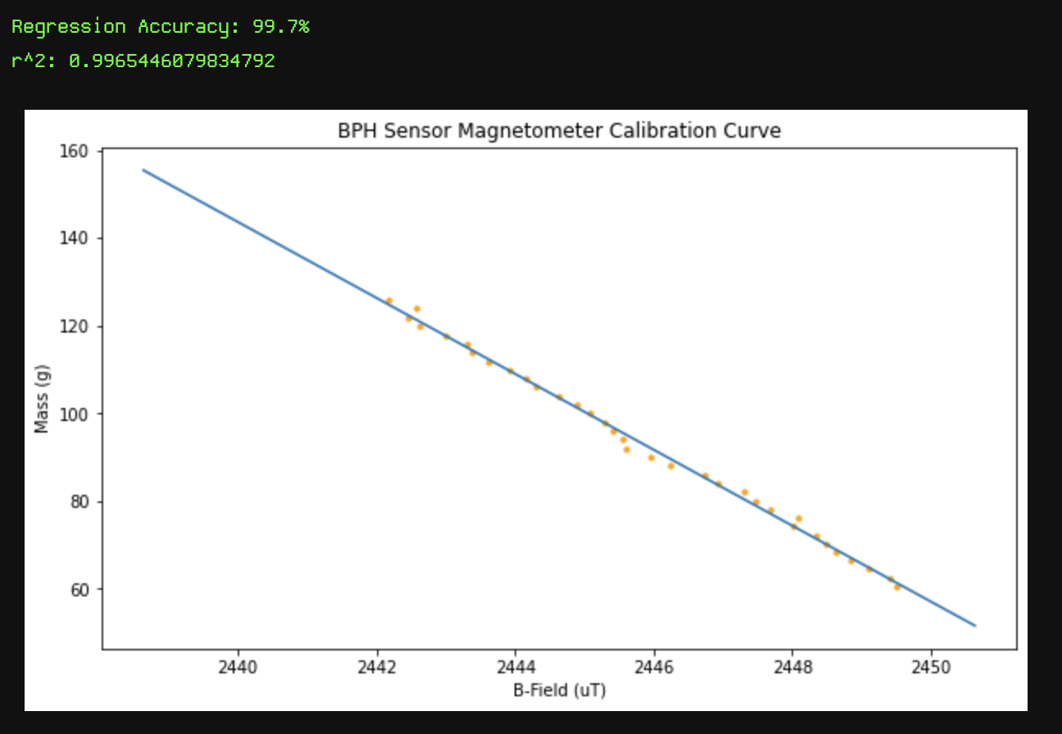
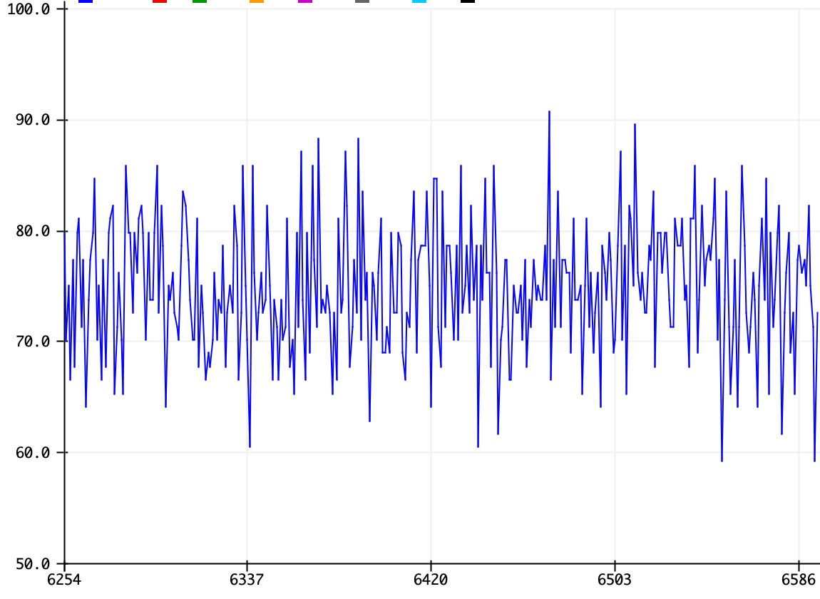
Discussion
While debugging to find the weak points of the design, I noticed that the sensor readings oscillate as shown below. The previous procedure did not account for this oscillation. To address this issue, I implemented a digital filter algorithm (exponential moving average), which increased the r² value to ~0.997.
Cleaned Data
Oscillating Data

Slide 22
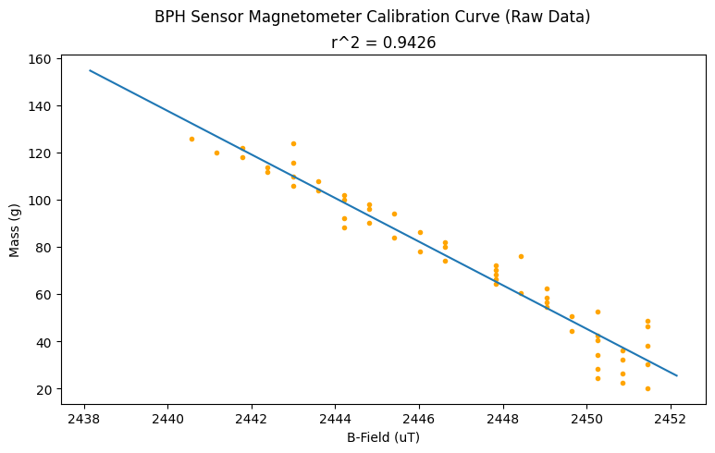
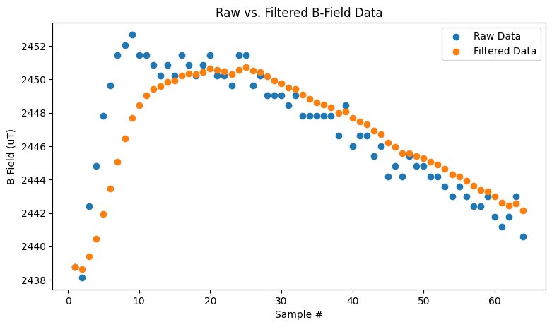
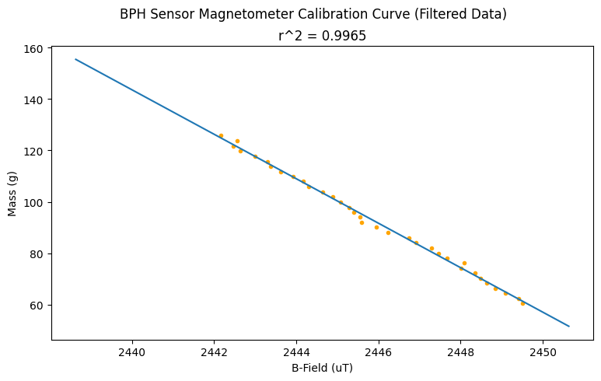
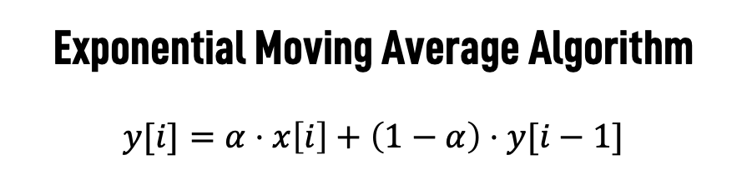
Exponential Moving Average Algorithm
$$y[i]=α⋅x\left[i\right]+\left(1−α\right)⋅y[i−1]$$
Filter

Slide 23
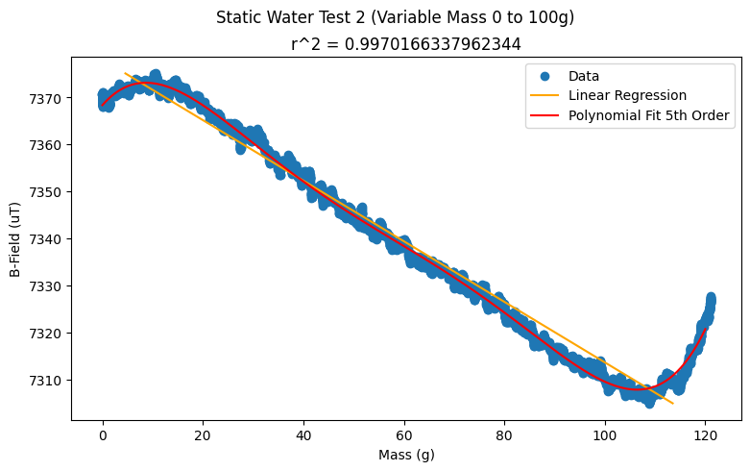
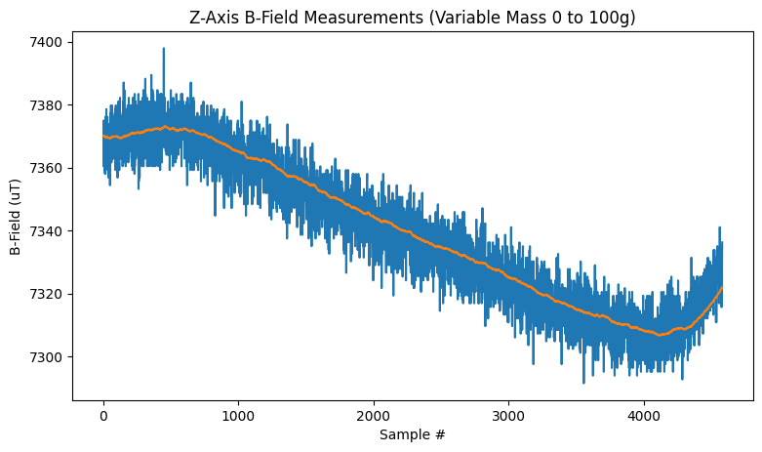
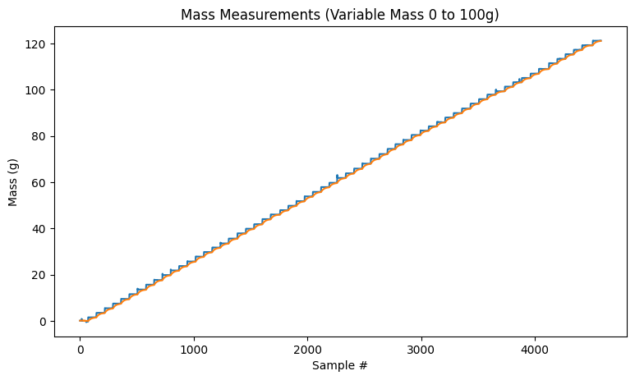

Slide 24
Problems
After conducting more rigorous tests, I found that this high correlation is attributed to the drift, not the actual mass reading.
False Negative Test – Did not add any water, but results show a large drift
Reverse Test – Started with 100g of water and started removing mass, but curve was still the same
Long Term False Negative Test – Same as #1, except I ran the experiment for an entire day (over 1.1 million data points). Curve displays low frequency sinusoidal noise
Ground Test – Measured magnetometer readings without including the elastomer

Slide 25
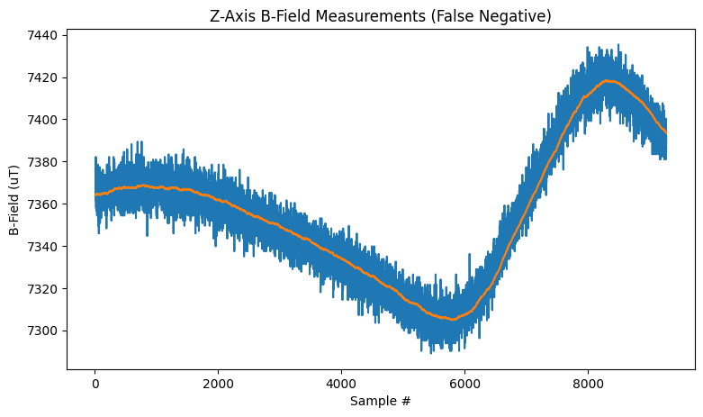
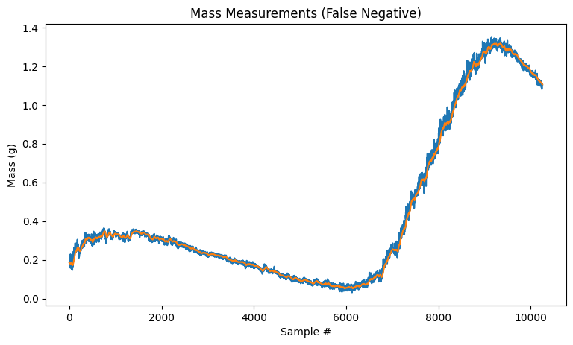
False Negative Test Results

Slide 26
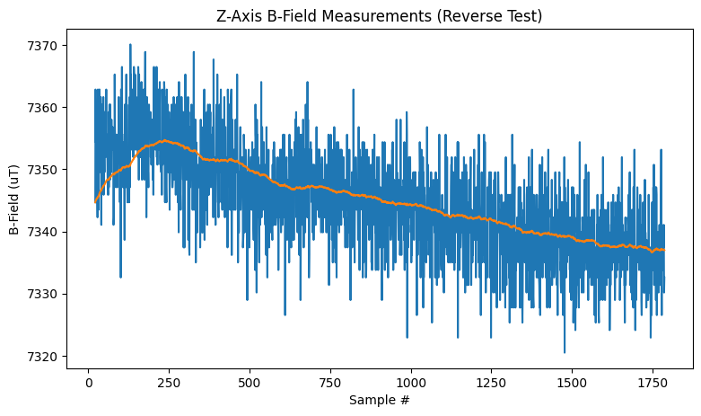
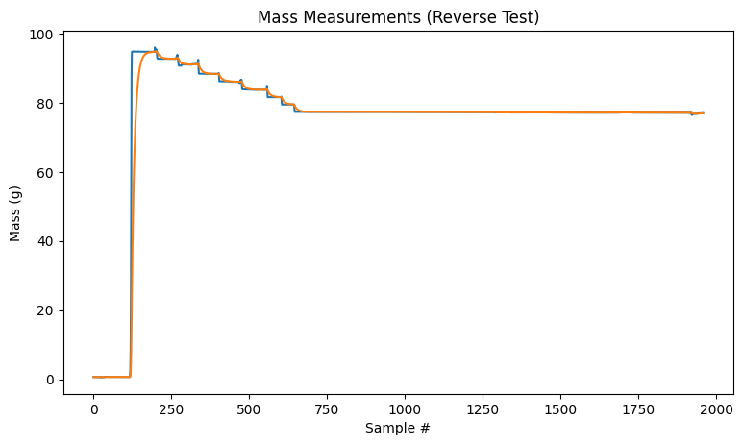
Reverse Test Results

Slide 27
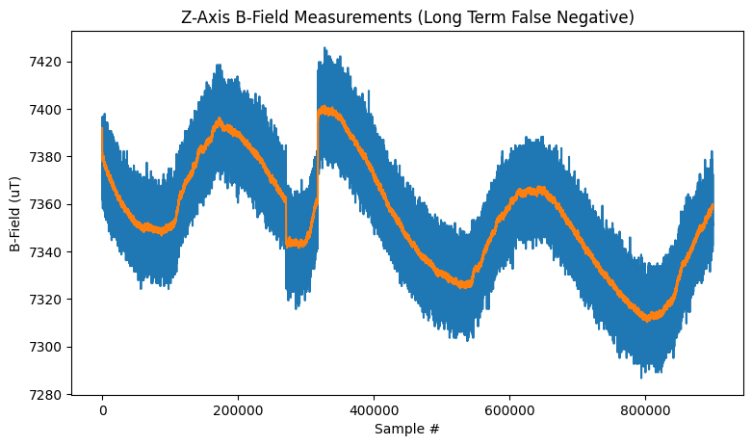
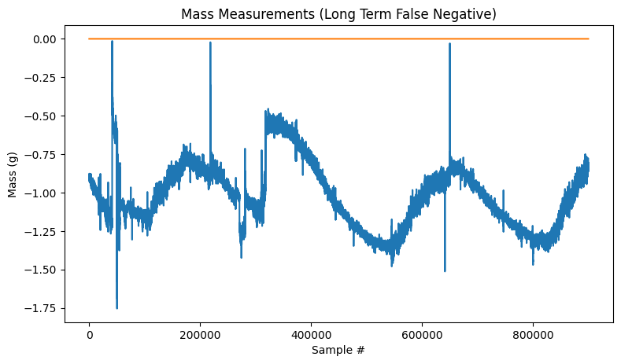
Long Term False Negative Test Results

Slide 28
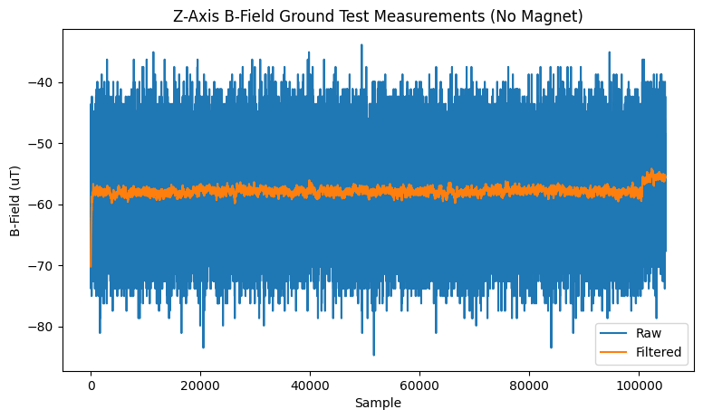
Ground Test Results

Slide 29
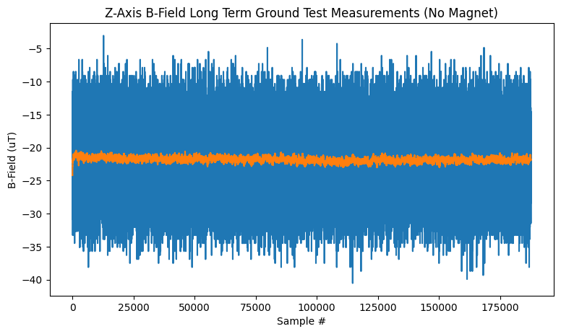
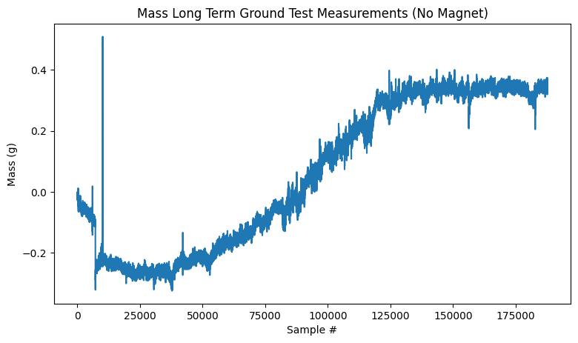
Long Term Ground Test Results

Slide 30







Discussion
Sine
Power
Wiring
Filter
Casing
Ground

Slide 31
Discussion
A few noteworthy observations I made from this data are:
The drift is clearly a sinusoidal noise. The source is still to be determined.
The magnetometer and the load cell drift in the same direction and at the same pace. I hypothesize that this can be addressed using the following:
The power from the Arduino might not be stable enough for the sensors. To verify this, redo the tests with a PSU that is reliably steady
The wiring might not be stable. To address this, try getting a circuit board printed of my circuit, or try using shorter wires.
Use an oscilloscope to determine the noise frequency and develop a filter to remove the noise.
Make a case that covers the test apparatus to mitigate any environmental factors such as dust or wind.
The ground test does not exhibit the same noise as the other tests, indicating that the sensor itself is not faulty.

Slide 32
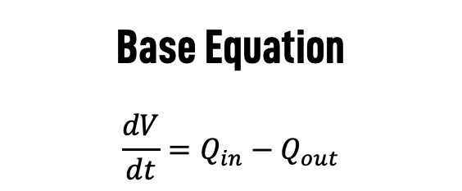

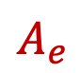
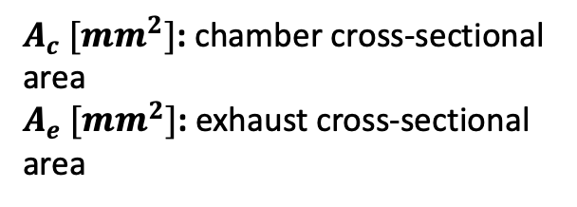


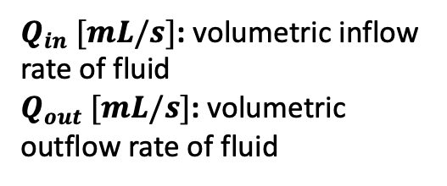

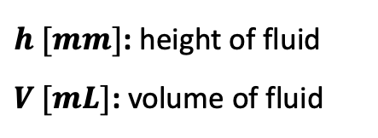

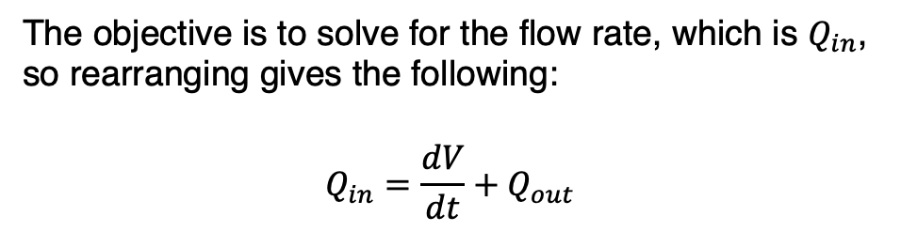
Dynamic Water Derivation
$$Q_{in}$$
Base Equation
$$\frac{dV}{dt}=Q_{in}−Q_{out}$$
$$A_{c}$$
$$h$$
$$V$$
$$Q_{out}$$
The objective is to solve for the flow rate, which is $Q_{in}$, so rearranging gives the following:
$$Q_{in}=\frac{dV}{dt}+Q_{out}$$
$$A_{e}$$
Variables
$h [mm]$: height of fluid
$V [mL]$: volume of fluid
$A_{c} [mm^{2}]$: chamber cross-sectional area
$A_{e} [mm^{2}]$: exhaust cross-sectional area
$Q_{in} [mL/s]$: volumetric inflow rate of fluid
$Q_{out} [mL/s]$: volumetric outflow rate of fluid

Slide 33







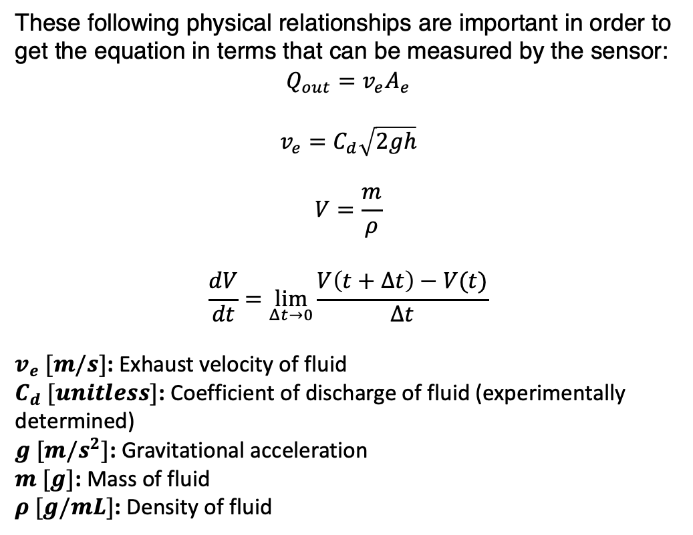
Dynamic Water Derivation
$$Q_{in}=\frac{dV}{dt}+Q_{out}$$
$$Q_{in}$$
These following physical relationships are important in order to get the equation in terms that can be measured by the sensor:
$$Q_{out}=v_{e}A_{e}$$
$$v_{e}=C_{d}\sqrt{2gh}$$
$$V=\frac{m}{ρ}$$
$$\frac{dV}{dt}=\lim_{Δt→0}{\frac{V\left(t+Δt\right)−V(t)}{Δt}}$$
$v_{e} [m/s]$: Exhaust velocity of fluid
$C_{d} [unitless]$: Coefficient of discharge of fluid (experimentally determined)
$g [m/s^{2}]$: Gravitational acceleration
$m [g]$: Mass of fluid
$ρ [g/mL]$: Density of fluid
$$A_{c}$$
$$h$$
$$V$$
$$Q_{out}$$
$$A_{e}$$

Slide 34

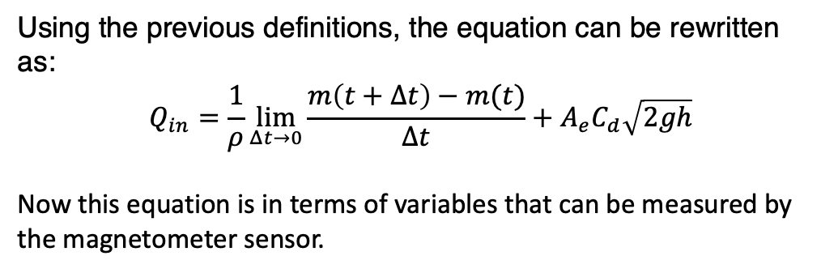
Dynamic Water Derivation
$$Q_{in}$$
$$A_{c}$$
$$Q_{in}=\frac{dV}{dt}+Q_{out}$$
Using the previous definitions, the equation can be rewritten as:
$$Q_{in}=\frac{1}{ρ}\lim_{Δt→0}{\frac{m\left(t+Δt\right)−m(t)}{Δt}}+A_{e}C_{d}\sqrt{2gh}$$
Now this equation is in terms of variables that can be measured by the magnetometer sensor.
$$h$$
$$V$$
$$Q_{out}$$
$$A_{e}$$

Slide 35
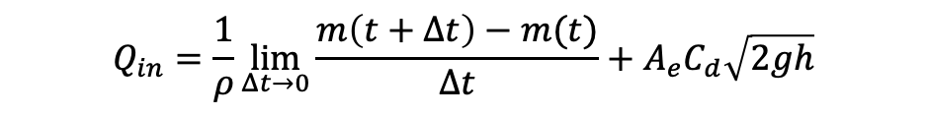
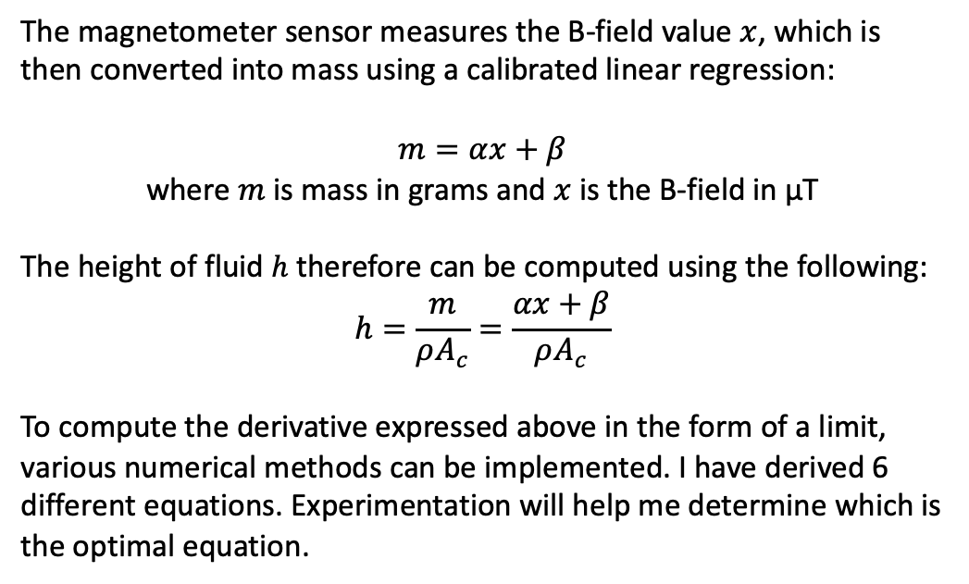
Dynamic Water Derivation
$$Q_{in}$$
$$Q_{in}=\frac{1}{ρ}\lim_{Δt→0}{\frac{m\left(t+Δt\right)−m(t)}{Δt}}+A_{e}C_{d}\sqrt{2gh}$$
$$A_{c}$$
The magnetometer sensor measures the B-field value $x$, which is then converted into mass using a calibrated linear regression:
$$m=αx+β$$
where $m$ is mass in grams and $x$ is the B-field in µT
The height of fluid $h$ therefore can be computed using the following:
$$h=\frac{m}{ρA_{c}}=\frac{αx+β}{ρA_{c}}$$
To compute the derivative expressed above in the form of a limit, various numerical methods can be implemented. I have derived 6 different equations. Experimentation will help me determine which is the optimal equation.
$$h$$
$$V$$
$$Q_{out}$$
$$A_{e}$$

Slide 36
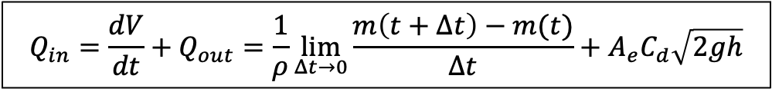
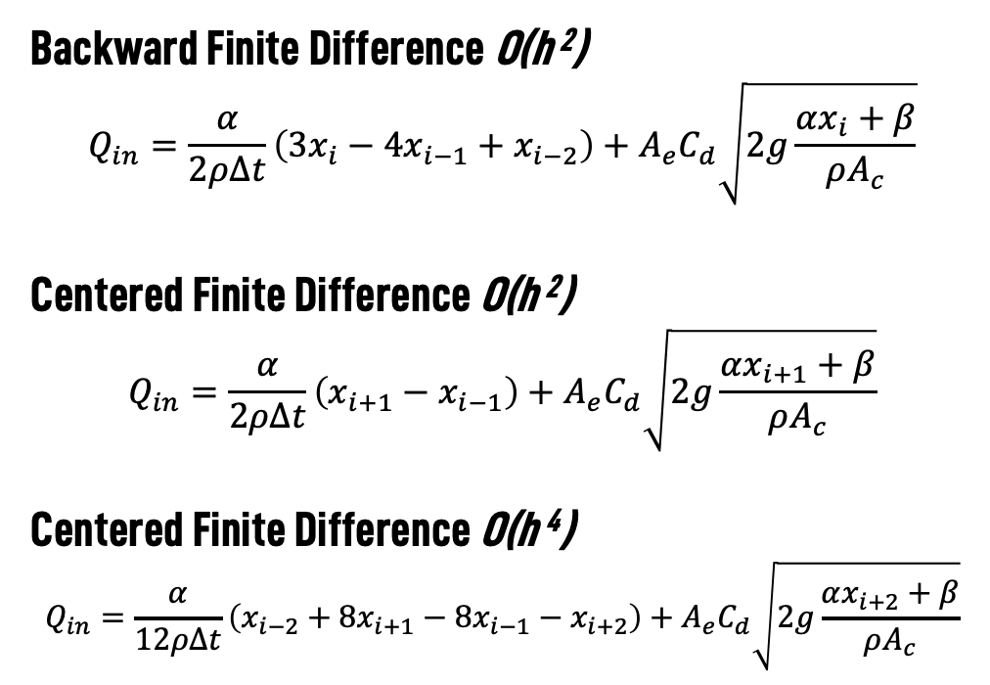
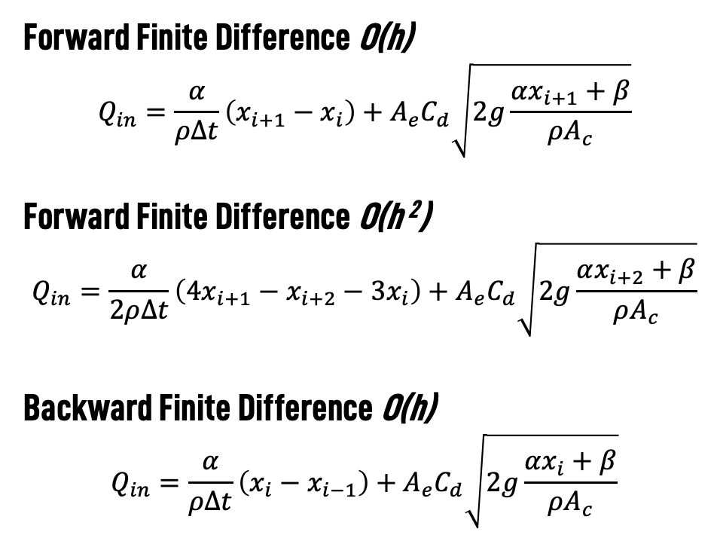
Numerical Methods
$$Q_{in}=\frac{dV}{dt}+Q_{out}=\frac{1}{ρ}\lim_{Δt→0}{\frac{m\left(t+Δt\right)−m(t)}{Δt}}+A_{e}C_{d}\sqrt{2gh}$$
Forward Finite Difference O(h)
$$Q_{in}=\frac{α}{ρΔt}\left(x_{i+1}−x_{i}\right)+A_{e}C_{d}\sqrt{2g\frac{αx_{i+1}+β}{ρA_{c}}}$$
Forward Finite Difference O(h ²)
$$Q_{in}=\frac{α}{2ρΔt}\left(4x_{i+1}−x_{i+2}−3x_{i}\right)+A_{e}C_{d}\sqrt{2g\frac{αx_{i+2}+β}{ρA_{c}}}$$
Backward Finite Difference O(h)
$$Q_{in}=\frac{α}{ρΔt}\left(x_{i}−x_{i−1}\right)+A_{e}C_{d}\sqrt{2g\frac{αx_{i}+β}{ρA_{c}}}$$
Backward Finite Difference O(h ²)
$$Q_{in}=\frac{α}{2ρΔt}\left(3x_{i}−{4x}_{i−1}+x_{i−2}\right)+A_{e}C_{d}\sqrt{2g\frac{αx_{i}+β}{ρA_{c}}}$$
Centered Finite Difference O(h ²)
$$Q_{in}=\frac{α}{2ρΔt}\left(x_{i+1}−x_{i−1}\right)+A_{e}C_{d}\sqrt{2g\frac{αx_{i+1}+β}{ρA_{c}}}$$
Centered Finite Difference O(h ⁴)
$$Q_{in}=\frac{α}{12ρΔt}\left(x_{i−2}+8x_{i+1}−8x_{i−1}−x_{i+2}\right)+A_{e}C_{d}\sqrt{2g\frac{αx_{i+2}+β}{ρA_{c}}}$$
Notes:
Note: This is the derivation for if there is a linear fit between mass and B-field such that mass = alpha*B_field + beta. For more accurate results, use the magnet equation from the research paper on tri-axis force measurement using a magnetic elastomer sensor.

Slide 37
Key
Container
Elastomer
Magnet
PCB
Arduino
Scale

Slide 38


Slide 39
Mass (g)
B-Field (uT)

